Slide 1
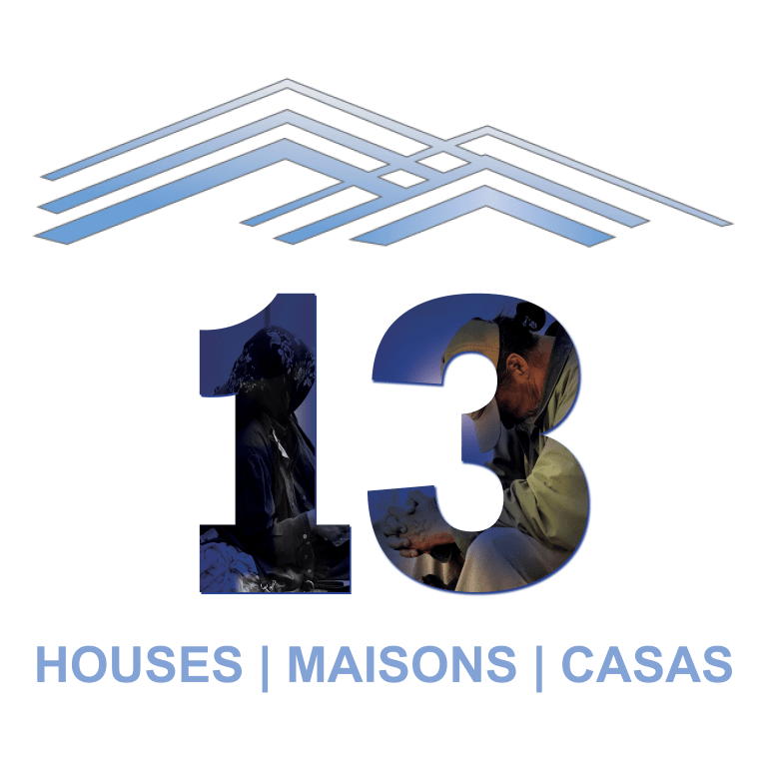
The Famvin Homeless Alliance presents
Lessons Learned from
13 Houses Projects
Led by Natalie Monteza, Campaign Coordinator
With special thanks to Dawn Colapietro, Ana María Escaño and Sr Winnie Mutuku

Slide 2
Para la traducción simultánea, por favor escojan su idioma haciendo clic debajo en el botón de interpretación
Pour accéder à la traduction simultanée, prière de sélectionner votre langue en cliquant sur le bouton interprétation ci-dessous
Para tradução simultânea, selecione o idioma de sua preferência clicando no botão de interpretação abaixo

Slide 3
Malitbog, Philippines
Lead group: Ana María Escaño, Vincentian Marian Youth
Aim: To build new houses for people living in inadequate and unsafe housing.
Beneficiaries: 30 (at least) very poor families living in undignified housing.
Systemic change: Food and nutrition support, access to medicine, development of small businesses
Partnerships: Vincentian Family institutions, local organisations and village officials
Fundraising/local contribution: Beneficiaries and the local community support building work and provide snacks to workers
Timescale: March 2021 – March 2022, one house at a time

Slide 4
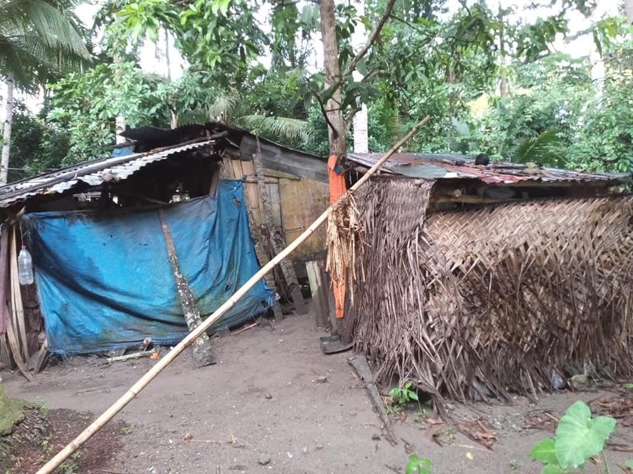
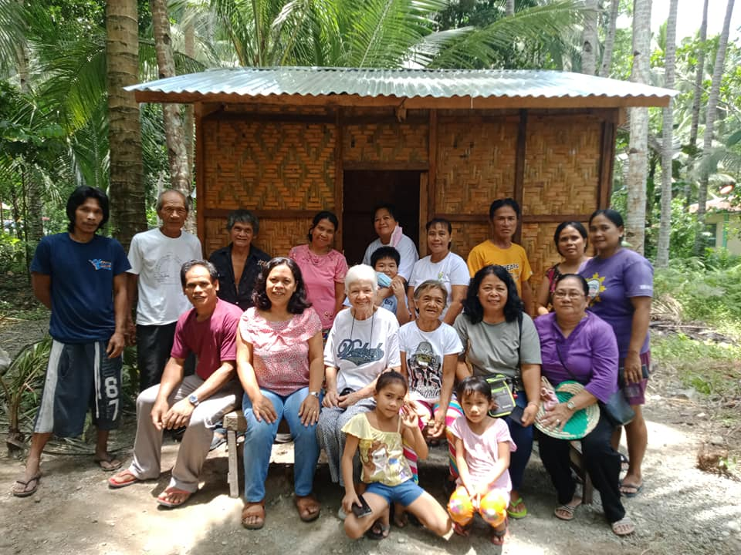
Malitbog, Philippines

Slide 5
Cuvier, Haiti
Lead group: Dawn Colapietro, Sisters of Charity of St. Elizabeth (SC)
Aim: Provide 13 homes for people who are homeless or living in inadequate housing.
Beneficiaries: 65 women and their children.
Systemic change: Vocational training (horticulture, sewing, cooking), financial advice (small business loans), relief during natural disasters, enrolling the children in school, ‘pay it forward’ programme (tending goats), water purification, free medical clinic
Partnerships: Dominican Sisters (DS)
Fundraising/local contribution: SC & DS grants, private donations
Timescale: 10 homes built since 2018, 3 to be finished before the end of 2021

Slide 6
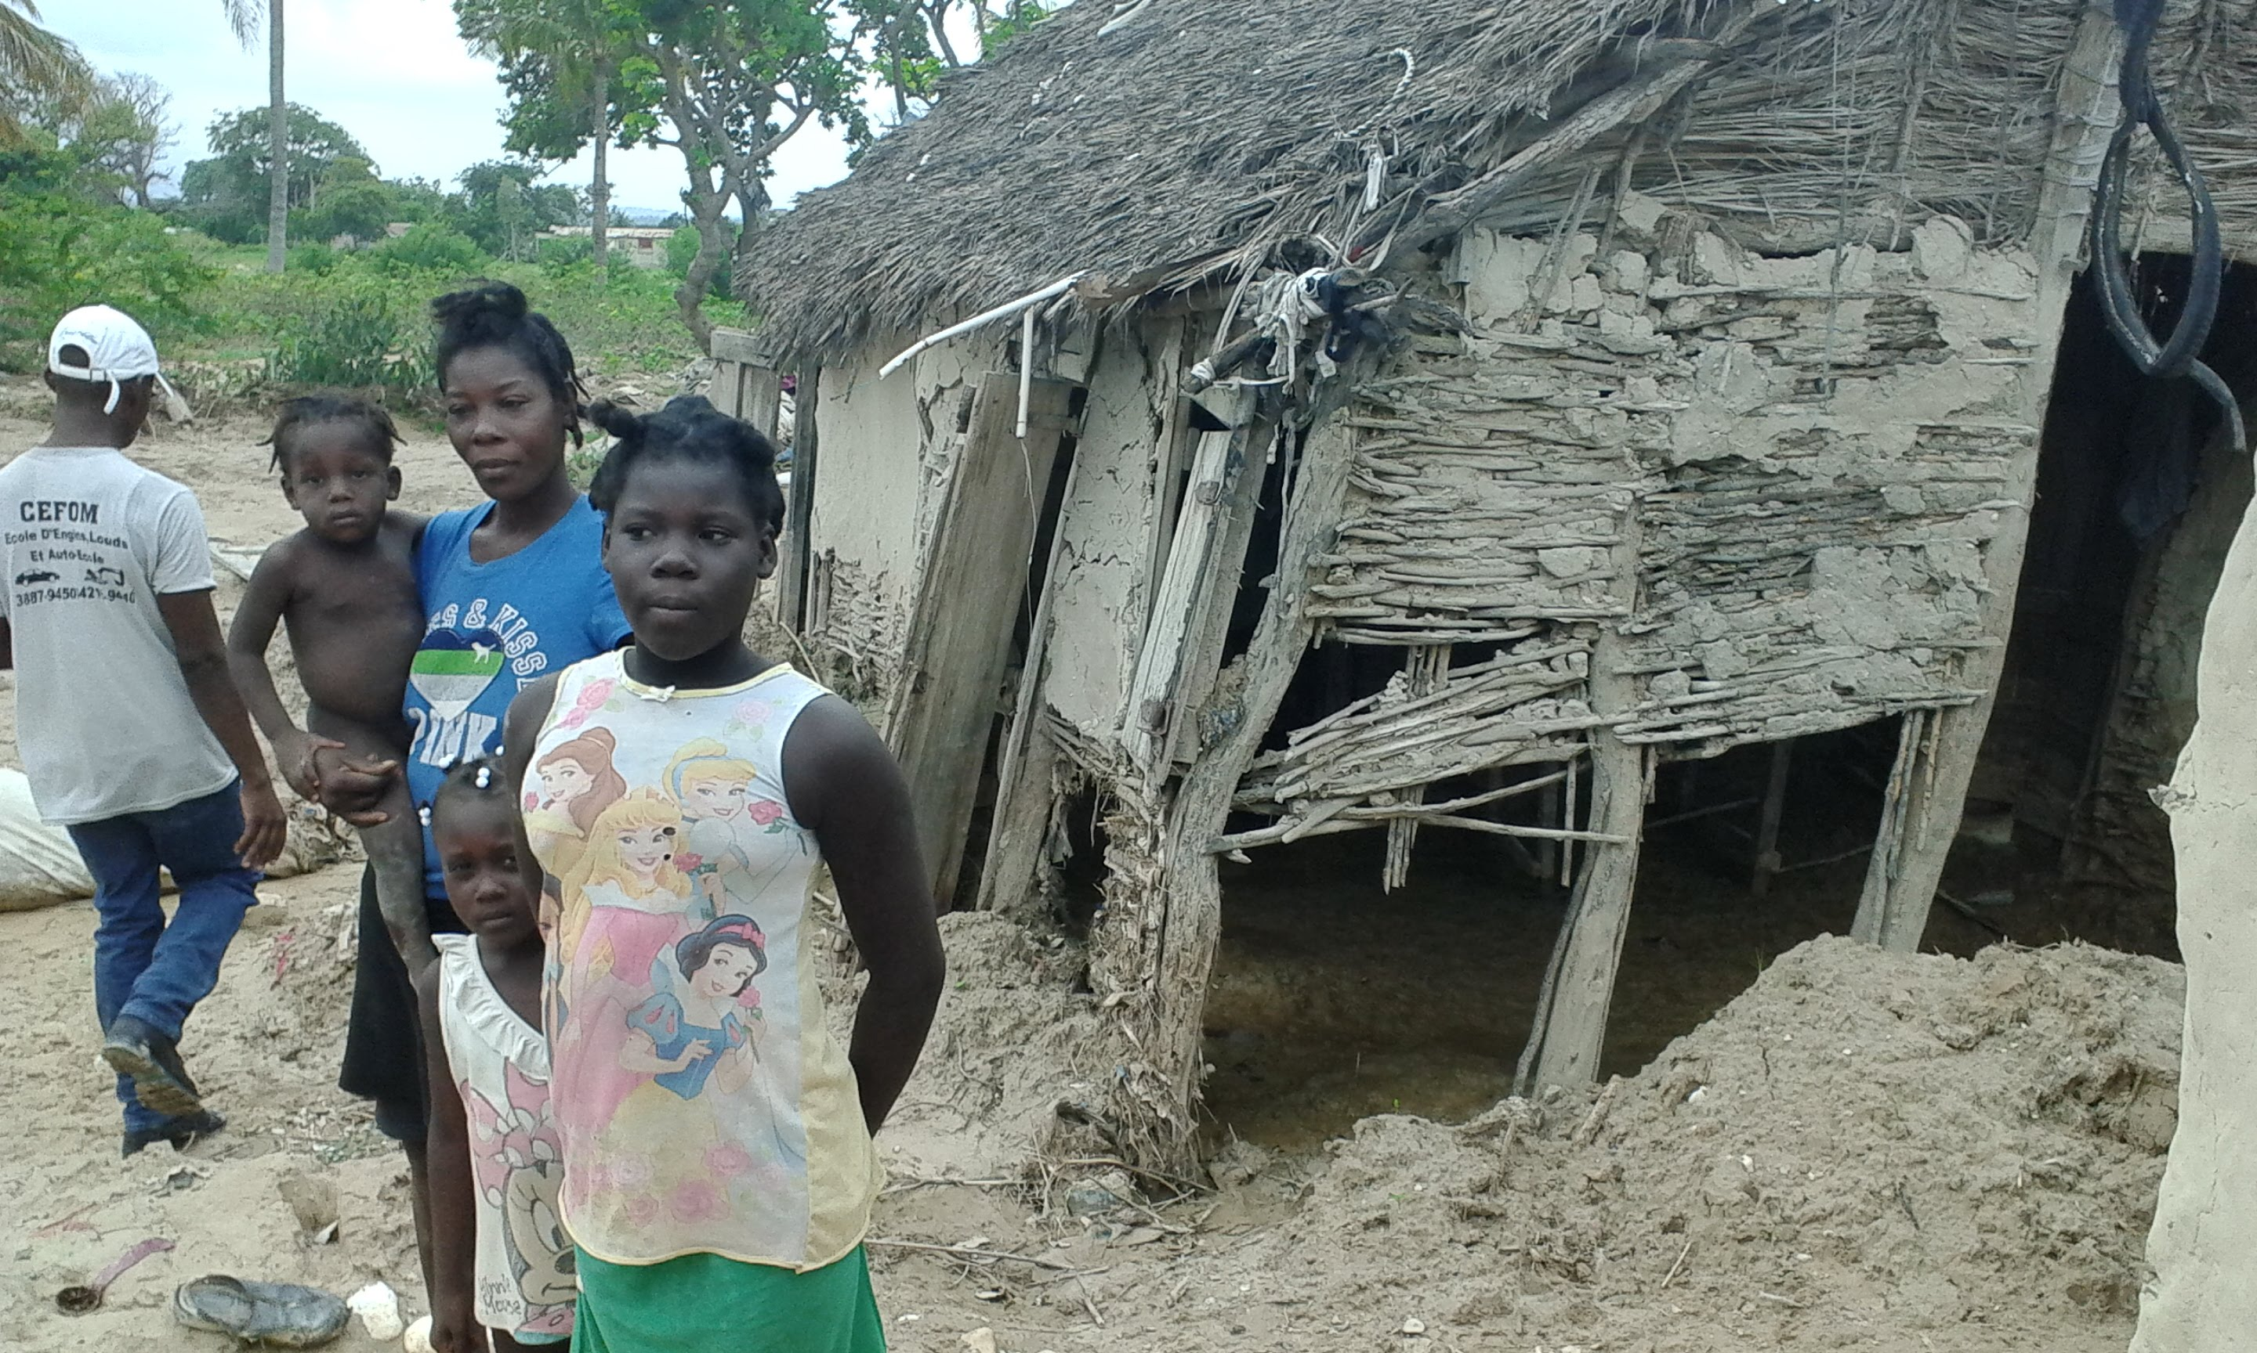
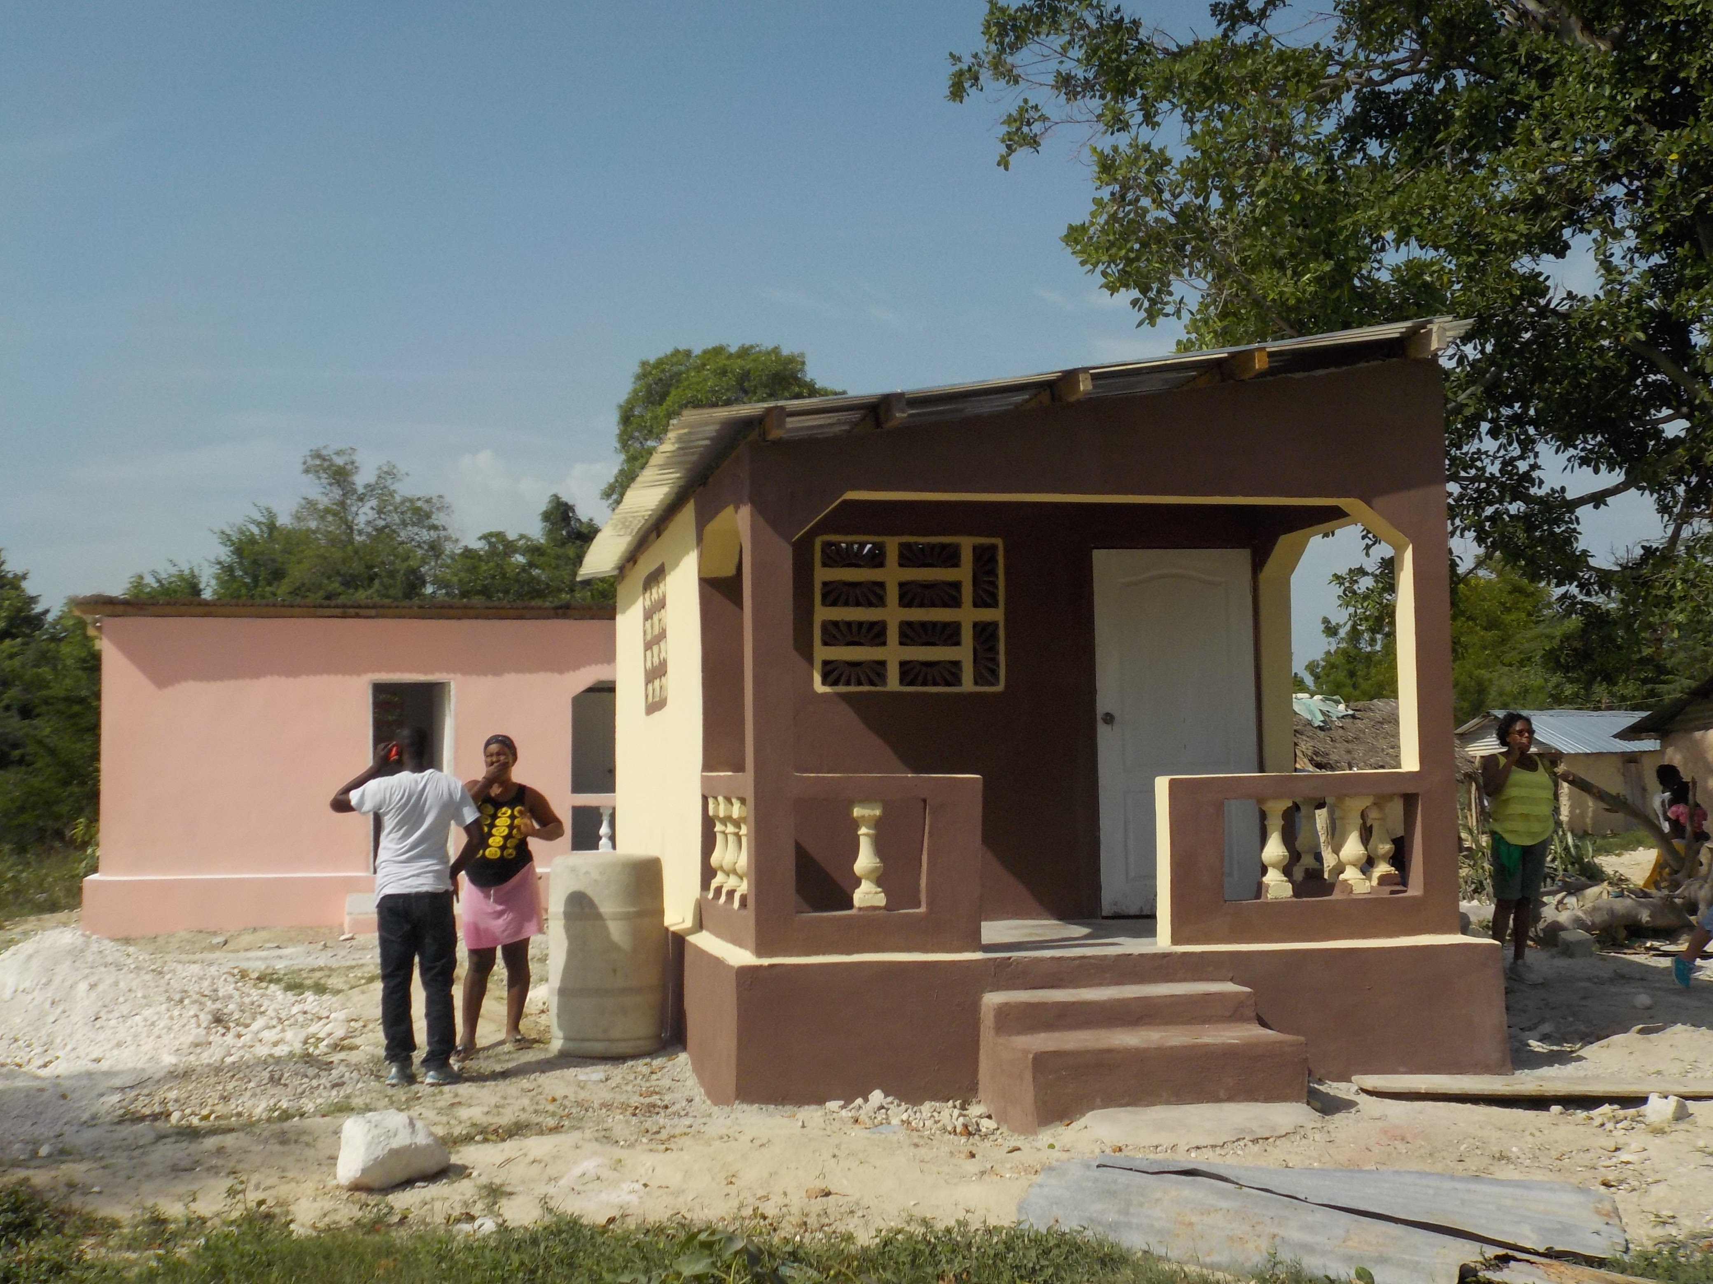
Cuvier, Haiti

Slide 7
Kitale, Kenya
Lead group: Sr Winnie Mutuku, Daughters of Charity
Aim: To transform the lives of vulnerable street children
Beneficiaries: 121 street children (so far), mostly boys, aged between 15-18
Systemic change: Mentoring and counselling, rebuilding family relationships, skills trainings, apprenticeships, access to education
Partnerships: Vincentian Fathers, SSVP, Ministry of Labour and Social Protection, Ursuline Sisters (medical care), Good Shepherd Sisters (family liaison) and local businesses
Fundraising/local contribution: Raised funds through private donors & DC contribution
Timescale: 4 year project, beginning 2019

Slide 8
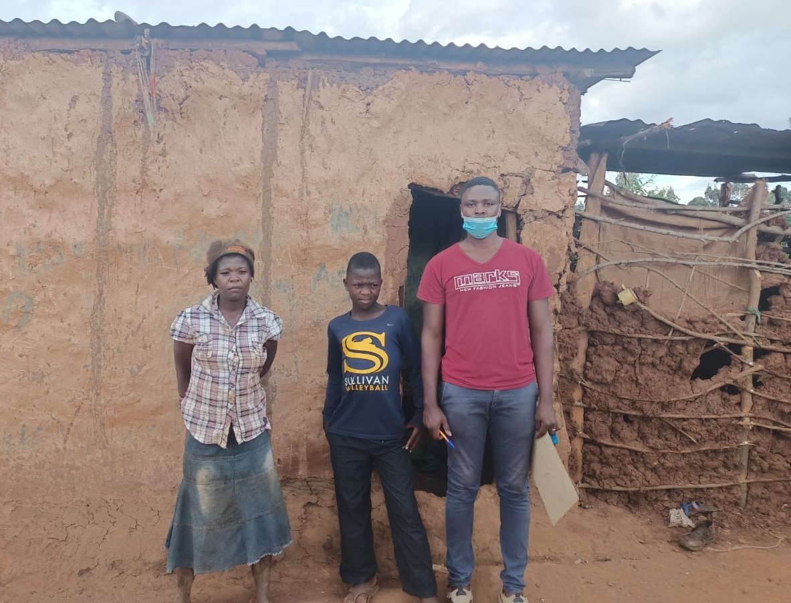
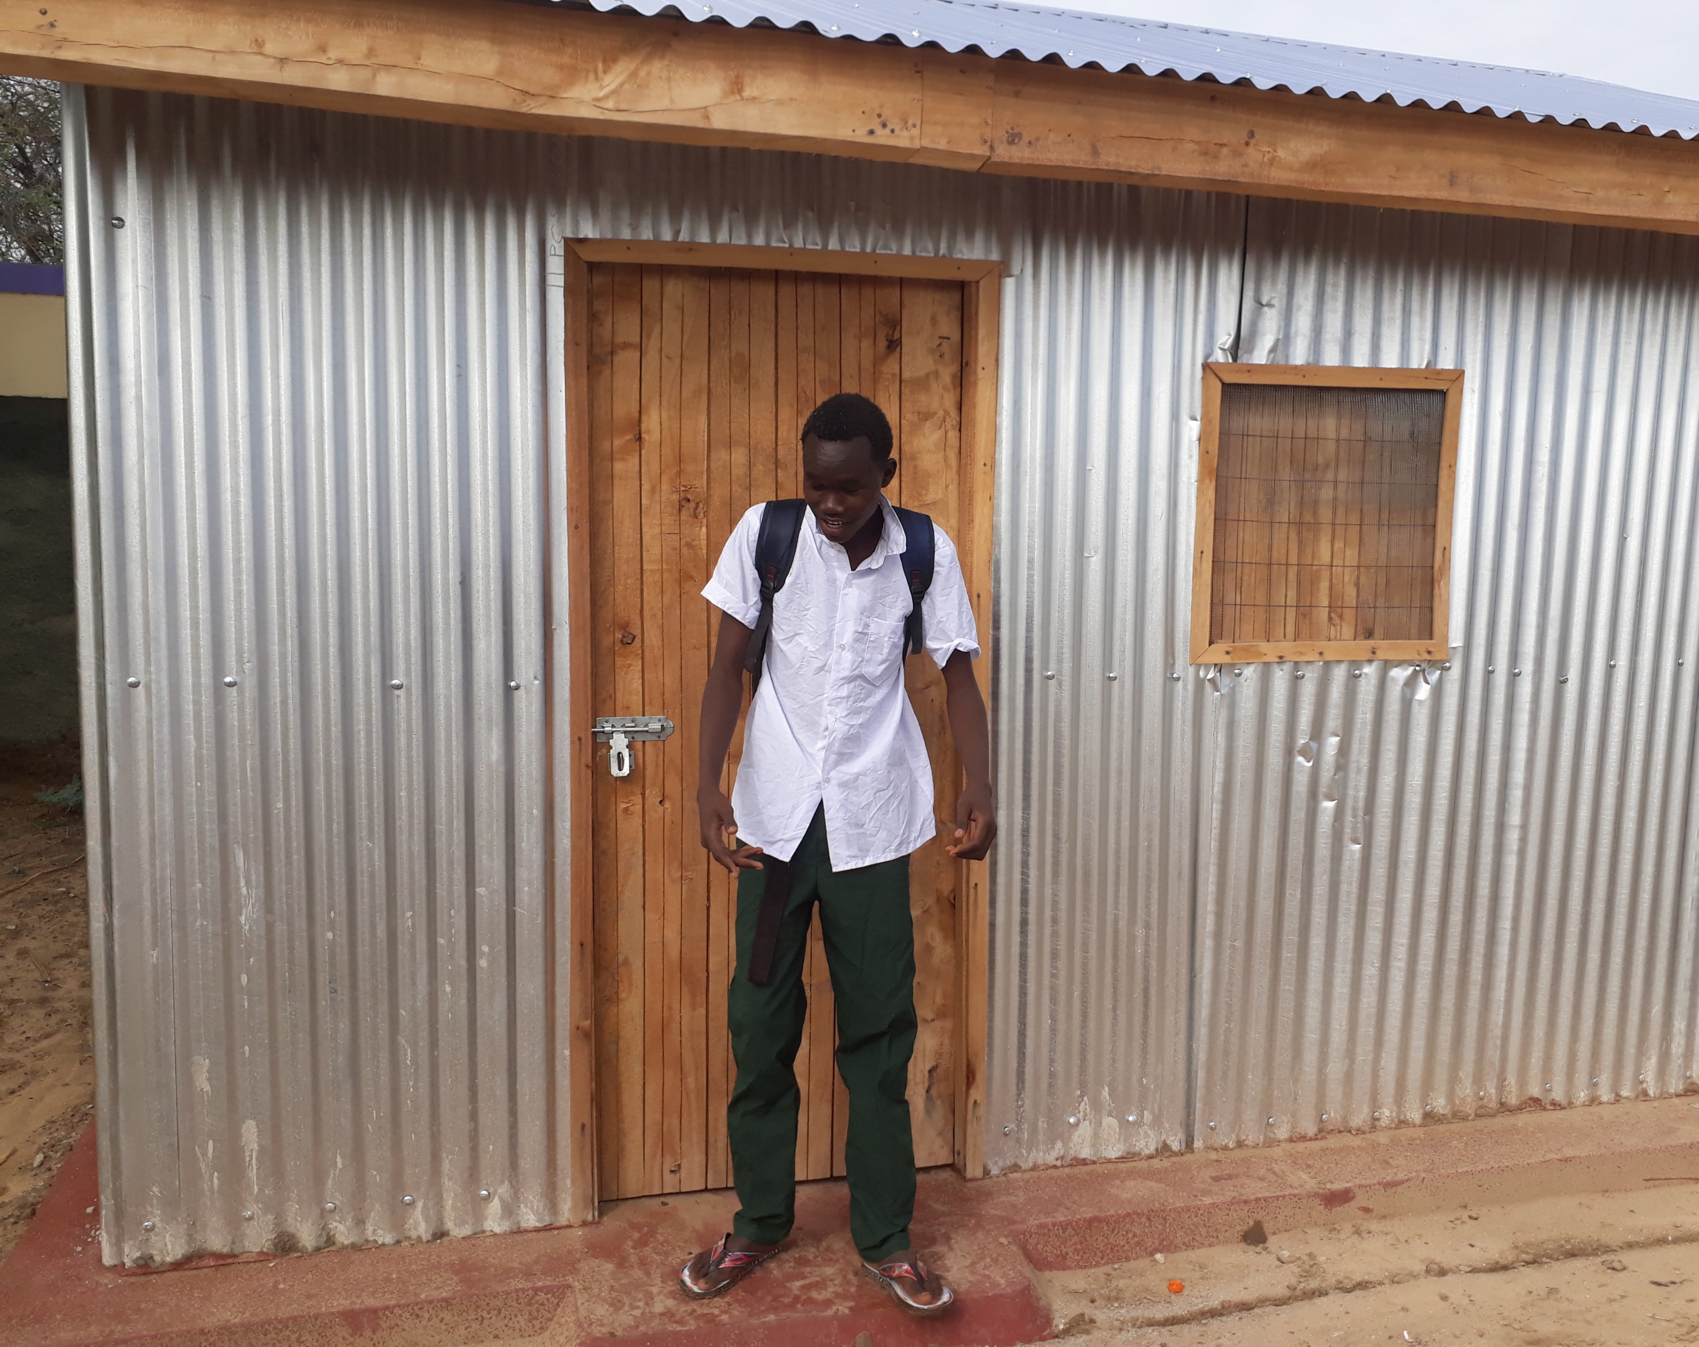
Kitale, Kenya

